Slide 1
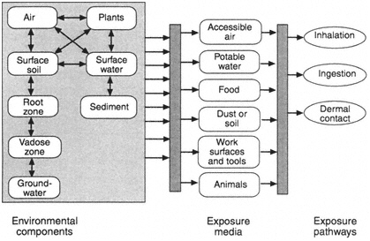
Source: National Academies Press
Source: National Academies Press

Slide 2
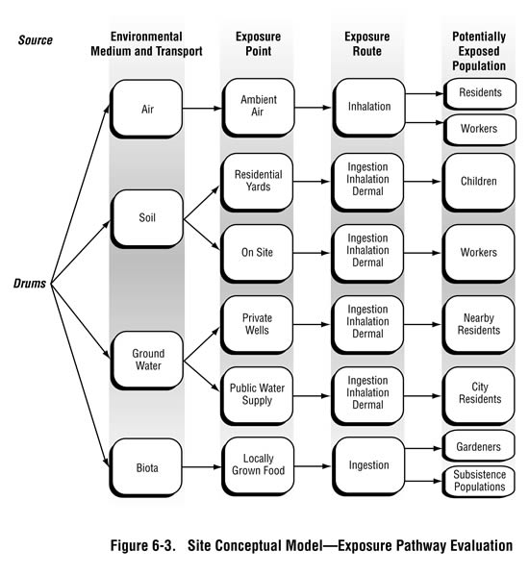
http://www.atsdr.cdc.gov/hac/PHAManual/ch6.html

